Slide 1




Community Logistic Preparedness
Oleg Livshitz

Slide 2
Introduction
Communities have the potential to function effectively and adapt successfully in the aftermath of disasters.
Community resilience is a process linking a network of adaptive capacities (resources with dynamic attributes) to adaptation after a disturbance or adversity.
Community resilience emerges from four primary sets of adaptive capacities—Economic Development, Social Capital, Information and Communication, and Community Competence—that together provide a strategy for disaster readiness
(Norris, F et al. (2008). Community resilience as a metaphor, theory, set of capacities, and strategy for disaster readiness.)

Slide 3
Community description analysis
Structure of community leadership
Number of members in the community.
The characteristics of the community (religious , cohesiveness, ….)
Geodemographic characteristics - Is it a closed community or not? How are they are spread around the city, district and country?
Community activities, social events and relationships.
Number of community institutions linked to the community (owned by, operated by, affiliated with)

Slide 4
Mission statement
Functional continuity of the community and its institutions after an event

Slide 5
Type of disasters
Human-induced Disasters | Natural Disasters
Accidents | Volcanoes
Crime | Lightning
Cyber crimes | Death of key person
Strikes | Epidemics
Chemical spills | Earthquakes
Explosions | Fires
Technological breakdowns | Floods
Sabotage | Meteorites
Terrorism | Severe weather conditions
Famine | Tsunamis
Nuclear, biological and radiological threats | Hurricane or typhoon
Riots | Tornado or severe windstorm
Dam failures | Landslide or mudslide
Fires | Electrostatic discharge
Epidemics | Dust contamination

Slide 6
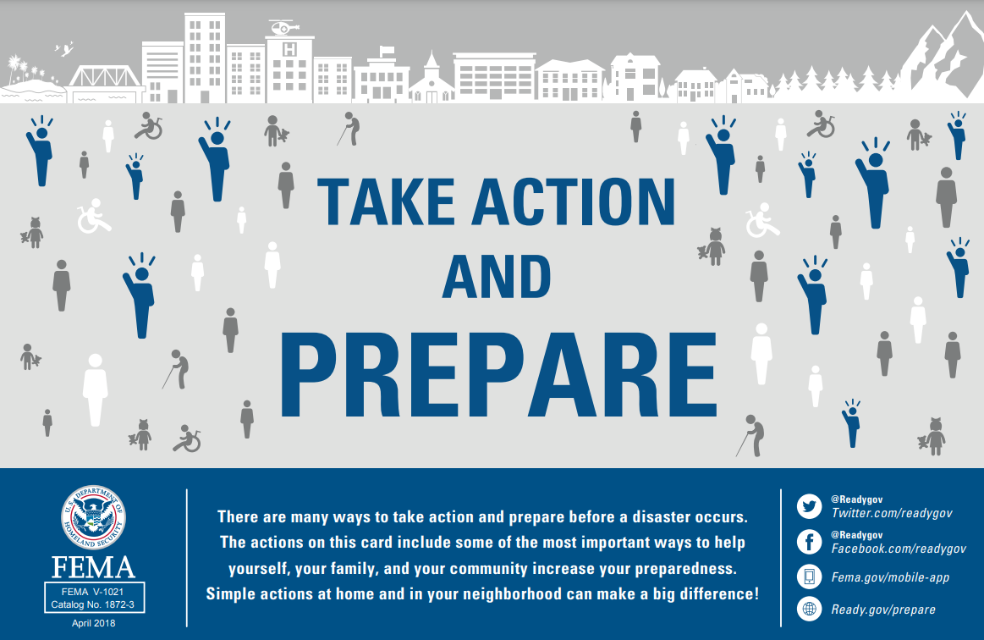
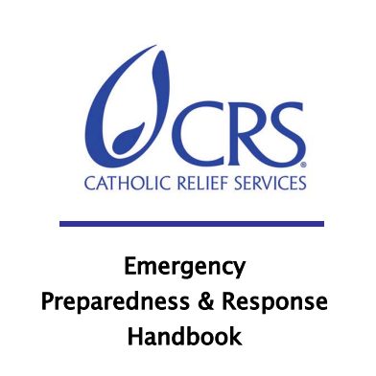

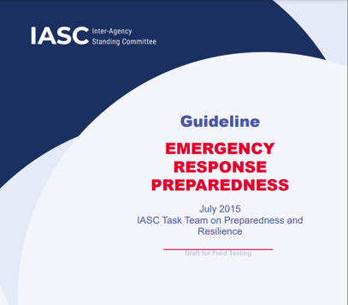
Emergency Response Preparedness Guides…….

Slide 7
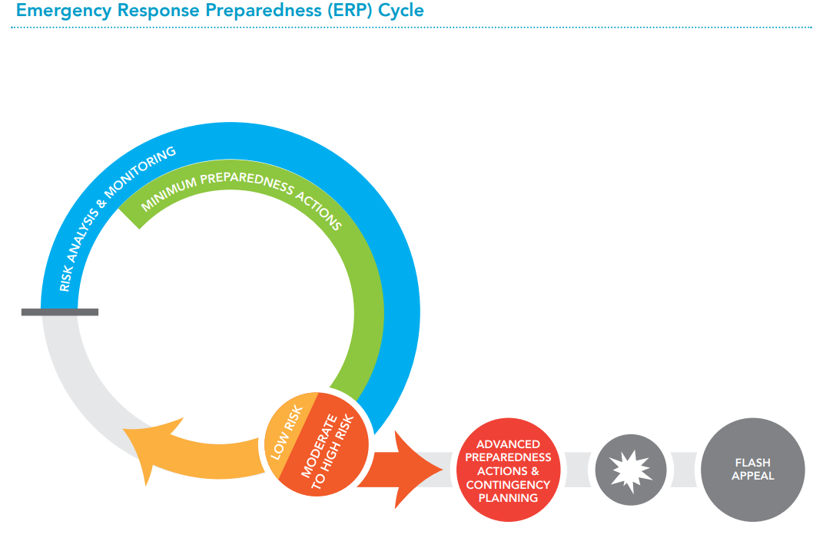
IASC emergency response preparedness approach in brief – as example
The IASC Emergency Response Preparedness (ERP) Approach provides a systematic and coherent multi-hazard approach to emergency preparedness, which enables humanitarian actors to prepare themselves for rapid, effective and efficient action.
The ERP Approach has three components:
  Hazard Identification, Risk Assessment and Risk Monitoring
  Minimum Preparedness Actions (MPA)
  Contingency Planning and Advanced Preparedness Actions

Slide 8
Israel’s NEMA national goal/service approach
Shelter
Food security
WASH
Providing Information
Health
Search and Rescue
Transportation and free movement
Education
Religious services
Finance stability
Continuity of operational and decision-making
Environment damage prevention
Maintaining law and order
Providing military needs
Protection

Slide 9
OCHA
THE CLUSTER APPROACH

Slide 10
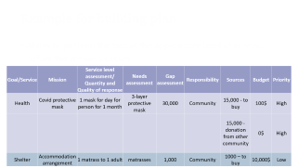
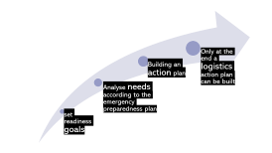
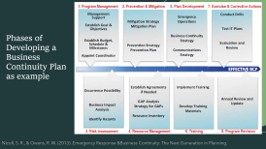
The planning at the macro
Logistics is part of the emergency preparedness plan
The logistical response is based on an analysis of scenarios and needs
How to do it…….

Slide 11
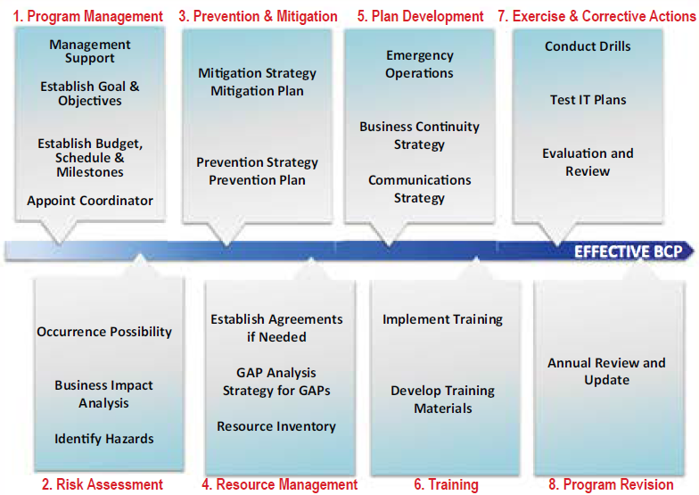
Phases of Developing a Business Continuity Plan as example
Nicoll, S. R., & Owens, R. W. (2013). Emergency Response &Business Continuity: The Next Generation in Planning.

Slide 12
set readiness goals
Analyse needs according to the emergency preparedness plan
Building an action plan
Only at the end a logistics action plan can be built

Slide 13
Example for building plan
Ability to perform the task at the appropriate level of service, before the scenario occurs
Goal/Service | Mission | Service level assessment/ Quantity and Quality of response | Needs assessment | Gap assessment | Responsibility | Sources | Budget | Priority
Health | Covid protective mask | 1 mask for day for person for 1 month | 3-layer protective mask | 30,000 | Community | 15,000 - to buy | 100$ | High
 |  |  |  |  |  | 15,000 - donation from other community | 0$ | High
Shelter | Accommodation arrangement | 1 matrass to 1 adult | matrasses | 1,000 | Community | 1000 – to buy | 10,000$ | Low

Slide 14
Disaster and post-disaster process flow
Preliminary Assessment and Needs Assessment – As a result of the pre-disaster plans and preparations as well as the preliminary assessment at the time of the disaster, the required information, materials and personnel requested during the disaster response and assistance process are delivered to the region as soon as possible.
Logistics Action Plan –To determine the most optimal transportation mode of materials and personnel, as well as storage locations of provisions is done by taking into consideration the region where the disaster occurred
Adiguzel, S. (2019). Logistics management in disaster.

Slide 15
Disaster and post-disaster process flow
Implementation of the Logistics Action Plan - Shipment of existing materials, personnel and equipment to the disaster area in accordance with the itinerary plan.
Monitoring and Evaluation of the Response - Evaluation and analysis of the disaster process by a commission that is not involved in the activities, reporting the results and storing them in case of need in the later cases.
Adiguzel, S. (2019). Logistics management in disaster.

Slide 16
Logistic system goal
In essence a logistics system delivers the appropriate supplies, in good condition, in the quantities required, and at the time and place they are needed.

Slide 17
The supply chain
“A supply chain is essentially a network consisting of suppliers, manufacturers, distributors, retailers and customers. The network supports three types of ‘flows’ that require careful design and close coordination: material flows, information flows and financial flows”
(Van Wassenhove, L. N. (2006), Humanitarian aid logistics: supply chain management in high gear.)

Slide 18
Building a logistic action plan - Steps
Assessment of the current abilities
  Team members – number, skill sets, availability
  Infrastructure – Warehouses, storage places, tools
  Distribution – does one exist, and in what scope?
  Stock – variance, quantity (minimum)
  Working environment
  Energy infrastructure

Slide 19
Building a logistic action plan - steps
Presentation of possible solutions
  An organized flowchart for key personnel for emergency mode
  Creation of contact list and addresses of vital institutes
  Creation of agreed upon schedule for requests and assignments to be known in all levels, with ability to respond to on-demand requests
  Publication of a stock list
  Building a periodical status report on:
    Stock
    Manpower
    Transportation
    Routes

Slide 20
Building a logistic action plan - steps
Classification of inventory
  Clothing
  Medical equipment and device
  Food (incl. religious needs)
  Kitchen tools
  Religious inventory
  Communications
  Energy (Oils, Gasoline, Batteries)

Slide 21
Building a logistic action plan - steps
Presentation of possible solutions
  Building ties with suppliers/stores and writing agreements
  Is there expectation for governmental/intl. organizations/NGO interventions? How to incorporate their help?
  Assembling teams of volunteers that come with defined equipment from home
  Building supply chain plan including the last mile
  Building and classification of kits
  Field visits and observations

Slide 22
Building a logistic action plan - steps
Plan for communications
  Communication equipment – cell phones, radio devices
  Creation of maps with driving routes including alternative routes
  In case of absence of communications, using volunteers who can pass on written messages (by foot, bicycle or any other transportation device)

Slide 23
Building a logistic action plan
Writing protocols with all points mentioned above
Creation of response teams and definition of tasks
Creation of training methods, guides and facilities
Creation of drill scenarios
Simulation drills with leaders and key personnel
Programs revision

Slide 24
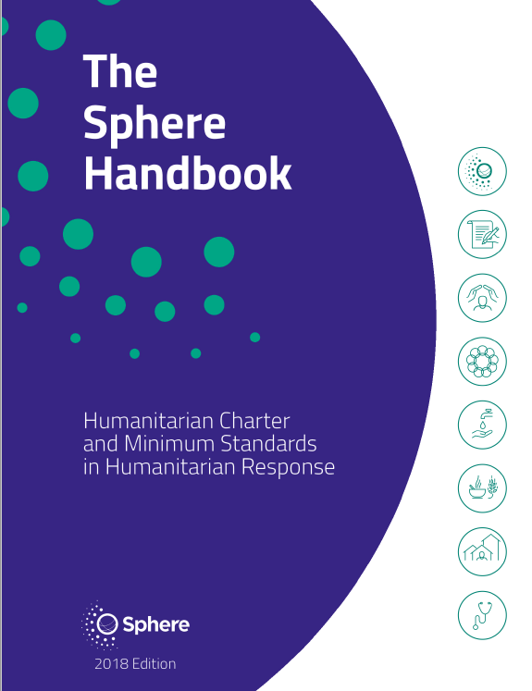
Adapt the response, including priorities to local circumstances.

